Slide 1
Recommendation Engine
Ayush Kumar

Slide 2
Types of Recommendation Engine
Recommend the most popular items
A simple approach could be to recommend the items which are liked by most number of users. This is a blazing fast and dirty approach and thus has a major drawback. The things is, there is no personalization involved with this approach.
Basically the most popular items would be same for each user since popularity is defined on the entire user pool. So everybody will see the same results. It sounds like, ‘a website recommends you to buy microwave just because it’s been liked by other users and doesn’t care if you are even interested in buying or not’.
Surprisingly, such approach still works in places like news portals. Whenever you login to say bbcnews, you’ll see a column of “Popular News” which is subdivided into sections and the most read articles of each sections are displayed. This approach can work in this case because:
There is division by section so user can look at the section of his interest.
At a time there are only a few hot topics and there is a high chance that a user wants to read the news which is being read by most others

Slide 3
Types of Recommendation Engine
Using a classifier to make recommendation
We already know lots of classification algorithms. Let’s see how we can use the same technique to make recommendations. Classifiers are parametric solutions so we just need to define some parameters (features) of the user and the item. The outcome can be 1 if the user likes it or 0 otherwise. This might work out in some cases because of following advantages:
Incorporates personalization
It can work even if the user’s past history is short or not available
But has some major drawbacks as well because of which it is not used much in practice:
The features might actually not be available or even if they are, they may not be sufficient to make a good classifier
As the number of users and items grow, making a good classifier will become exponentially difficult

Slide 4
Types of Recommendation Engine
Recommendation Algorithms
Content based algorithms:
Idea: If you like an item then you will also like a “similar” item
Based on similarity of the items being recommended
It generally works well when its easy to determine the context/properties of each item. For instance when we are recommending the same kind of item like a movie recommendation or song recommendation.

Slide 5
Types of Recommendation Engine
Collaborative filtering algorithms:
Idea: If a person A likes item 1, 2, 3 and B like 2,3,4 then they have similar interests and A should like item 4 and B should like item 1.
This algorithm is entirely based on the past behavior and not on the context. This makes it one of the most commonly used algorithm as it is not dependent on any additional information.
For instance: product recommendations by e-commerce player like Amazon and merchant recommendations by banks like American Express.

Slide 6
Types of Recommendation Engine
Further, there are several types of collaborative filtering algorithms :
User-User Collaborative filtering: Here we find look alike customers (based on similarity) and offer products which first customer’s look alike has chosen in past. This algorithm is very effective but takes a lot of time and resources. It requires to compute every customer pair information which takes time. Therefore, for big base platforms, this algorithm is hard to implement without a very strong parallelizable system.
Item-Item Collaborative filtering: It is quite similar to previous algorithm, but instead of finding customer look alike, we try finding item look alike. Once we have item look alike matrix, we can easily recommend alike items to customer who have purchased any item from the store. This algorithm is far less resource consuming than user-user collaborative filtering. Hence, for a new customer the algorithm takes far lesser time than user-user collaborate as we don’t need all similarity scores between customers. And with fixed number of products, product-product look alike matrix is fixed over time.
Other simpler algorithms: There are other approaches like market basket analysis, which generally do not have high predictive power than the algorithms described above.

Slide 7
The MovieLens DataSet
We will be using the MovieLens dataset for this purpose. It has been collected by the GroupLens Research Project at the University of Minnesota
It consists of:
100,000 ratings (1-5) from 943 users on 1682 movies.
Each user has rated at least 20 movies.
Simple demographic info for the users (age, gender, occupation, zip)
Genre information of movies

Slide 8
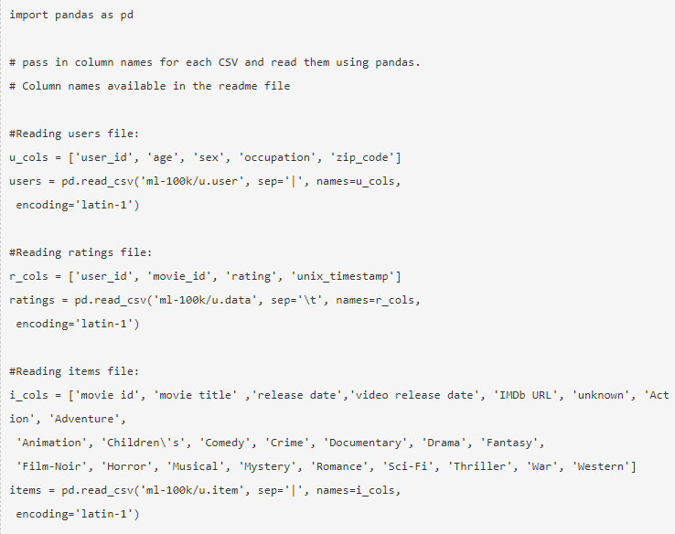
The MovieLens DataSet

Slide 9
A Simple Popularity Model
We can train a recommendation as:
Arguments:
train_data: the SFrame which contains the required data
user_id: the column name which represents each user ID
item_id: the column name which represents each item to be recommended
target: the column name representing scores/ratings given by the user

Slide 10
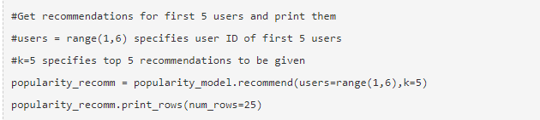
A Simple Popularity Model
Lets use this model to make top 5 recommendations for first 5 users and see what comes out:
This can be verified by checking the movies with highest mean recommendations in our ratings base data set:

Slide 11
Collaborative Filtering Model
Lets start by understanding the basics of a collaborative filtering algorithm. The core idea works in 2 steps:
Find similar items by using a similarity metric
For a user, recommend the items most similar to the items (s)he already likes
In this case, an item is a movie. Once we have the matrix, we use it to determine the best recommendations for a user based on the movies he has already rated. Note that there a few more things to take care in actual implementation which would require deeper mathematical introspection, which I’ll skip for now.

Slide 12
Metrics supported by Graph-lab
Three types of item similarity metrics supported by graphlab. These are:
Jaccard Similarity:
Similarity is based on the number of users which have rated item A and B divided by the number of users who have rated either A or B
It is typically used where we don’t have a numeric rating but just a boolean value like a product being bought or an add being clicked
Cosine Similarity:
Similarity is the cosine of the angle between the 2 vectors of the item vectors of A and B
Closer the vectors, smaller will be the angle and larger the cosine
Pearson Similarity
Similarity is the pearson coefficient between the two vectors.

Slide 13
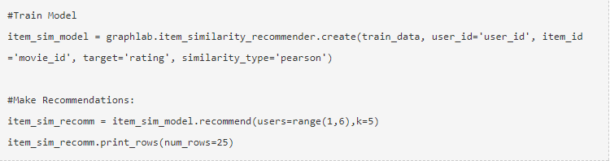
Lets create a mode based on the similarity

Slide 14
Evaluating Recommendation Engines
For evaluating recommendation engines, we can use the concept of precision-recall. You must be familiar with this in terms of classification and the idea is very similar. Let me define them in terms of recommendations.
Recall:
What ratio of items that a user likes were actually recommended.
If a user likes say 5 items and the recommendation decided to show 3 of them, then the recall is 0.6
Precision
Out of all the recommended items, how many the user actually liked?
If 5 items were recommended to the user out of which he liked say 4 of them, then precision is 0.8

Slide 15

Now if we think about recall, how can we maximize it? If we simply recommend all the items, they will definitely cover the items which the user likes. So we have 100% recall! But think about precision for a second. If we recommend say 1000 items and user like only say 10 of them then precision is 0.1%. This is really low. Our aim is to maximize both precision and recall.
An idea recommender system is the one which only recommends the items which user likes. So in this case precision=recall=1. This is an optimal recommender and we should try and get as close as possible.
Lets compare both the models we have built till now based on precision-recall characteristics:

Slide 16
Observations
The item similarity model is definitely better than the popularity model (by atleast 10x)
On an absolute level, even the item similarity model appears to have a poor performance. It is far from being a useful recommendation system.
In this PPT, we traversed through the process of making a basic recommendation engine in Python using GrpahLab. We started by understanding the fundamentals of recommendations. Then we went on to load the MovieLens 100K data set for the purpose of experimentation.
Subsequently we made a first model as a simple popularity model in which the most popular movies were recommended for each user. Since this lacked personalization, we made another model based on collaborative filtering and observed the impact of personalization.
Finally, we discussed precision-recall as evaluation metrics for recommendation systems and on comparison found the collaborative filtering model to be more than 10x better than the popularity model.

